Slide 1

THE COUNTRY OF HONOUR
Presentation

Slide 2





KEY FIGURES - IFTM 2025
The 1st B2B event for travel professionals in France
IFTM is the only B2B trade show that brings together all professionals of the French tourism industry: the Leisure, Business, MICE, and Group. IFTM is the starting point of a collective movement towards tourism that is more ambitious, more innovative, and deeply responsible.
32,022 visitors
1,650 Brands - 117 Destinations
16,725 Business meetings (+27,7 % vs 2025)
82 % French visitors / 18% International visitors
+90 Conference sessions
800 Press / Media / content creators

Slide 3
YOUR OBJECTIVES
Do you seek to enhance your country's image and prestige on the global tourism stage?
Are you looking to connect with key industry stakeholders and expand your network within the tourism sector?
Would you like to showcase your destination's unique culture and attractions to an audience of tourism leaders?
BE
THE COUNTRY OF HONOUR
AT IFTM

Slide 4
BE THE COUNTRY OF HONOUR
Ensure unprecedented visibility for your destination
Forge strategic partnerships and alliances
Have an immediate & long-term return on investment
Benefit from an exclusive exhibition and a privileged relationship with the entire IFTM community (partners, officials, institutions, press, distribution networks, Travel Agents, Tour Operators...)
Increase your business contacts & leads

Slide 5
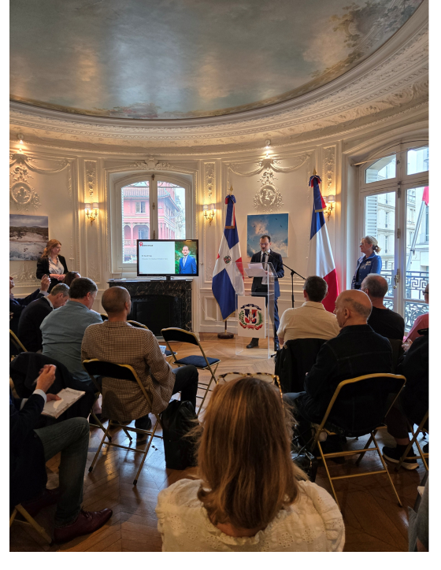
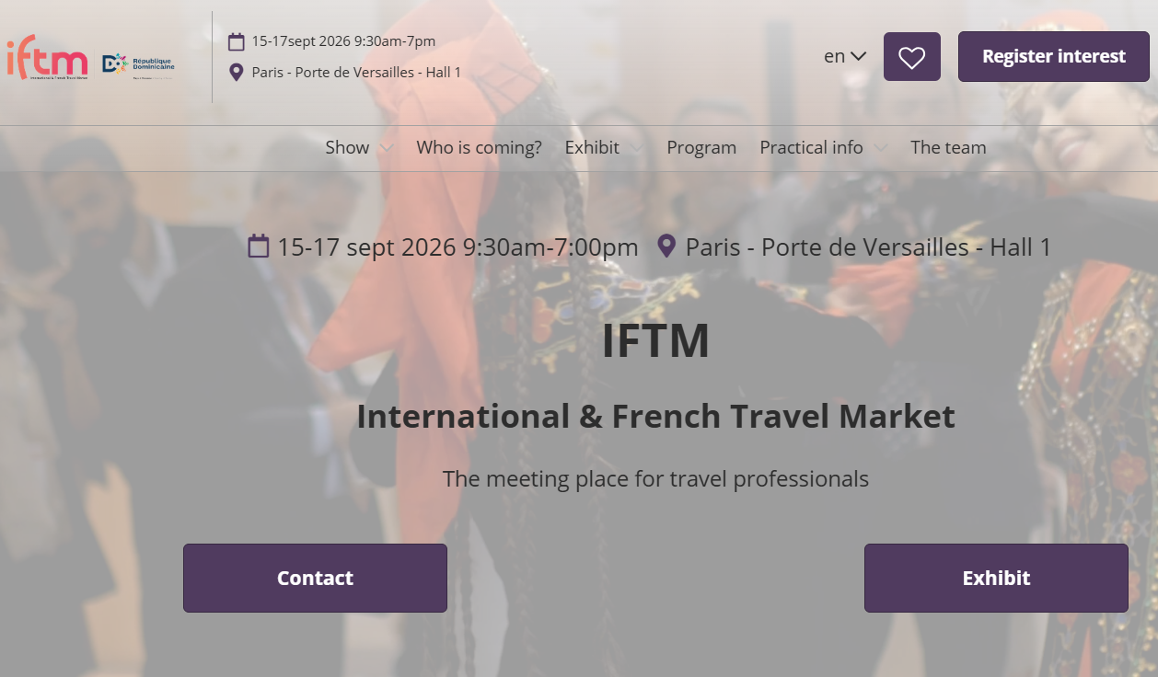

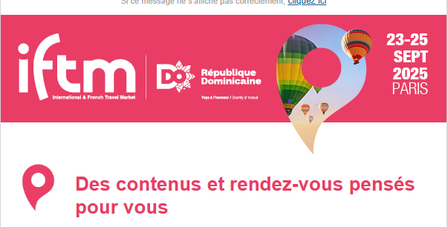
360° Communication
- EXCLUSIVE -
Your brand is co-branded with the IFTM communication
Events: Press conference & Exhibitors meeting
Announcement of the Country of honour during the ongoing show
in the presence of your officials and IFTM/RX France Management
Press announcements
Emailing & Newsletter KPI
+554,000 emails sent a year
+36% unique opening rate
Website KPI - IFTM - Le rendez-vous des professionnels du tourisme
+850,000 page views a year
+223,000 sessions a year
Social media KPI
+41,000 followers
+679,000 reach
+51,000 engagement
​Country of honour:
400K€
(advertising equivalence)

Slide 6
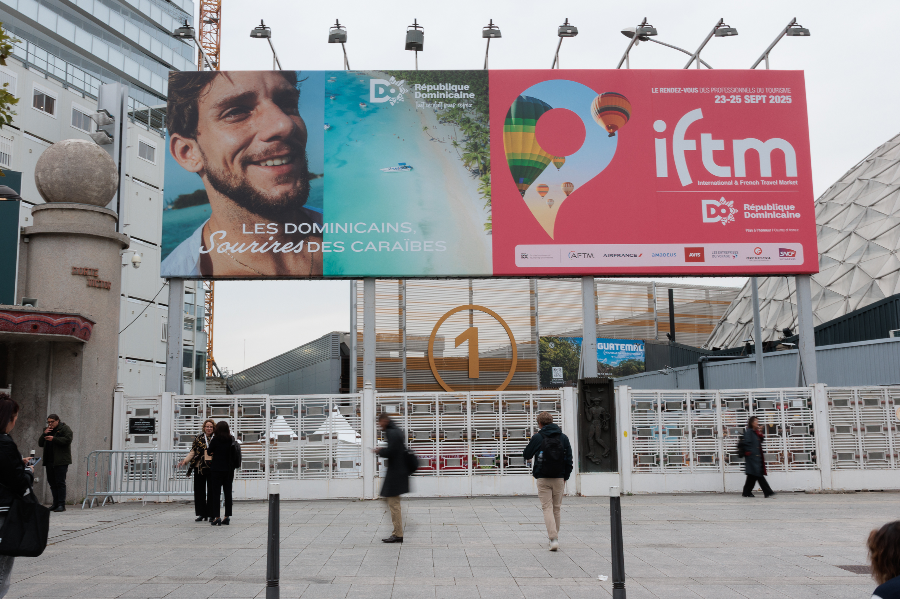
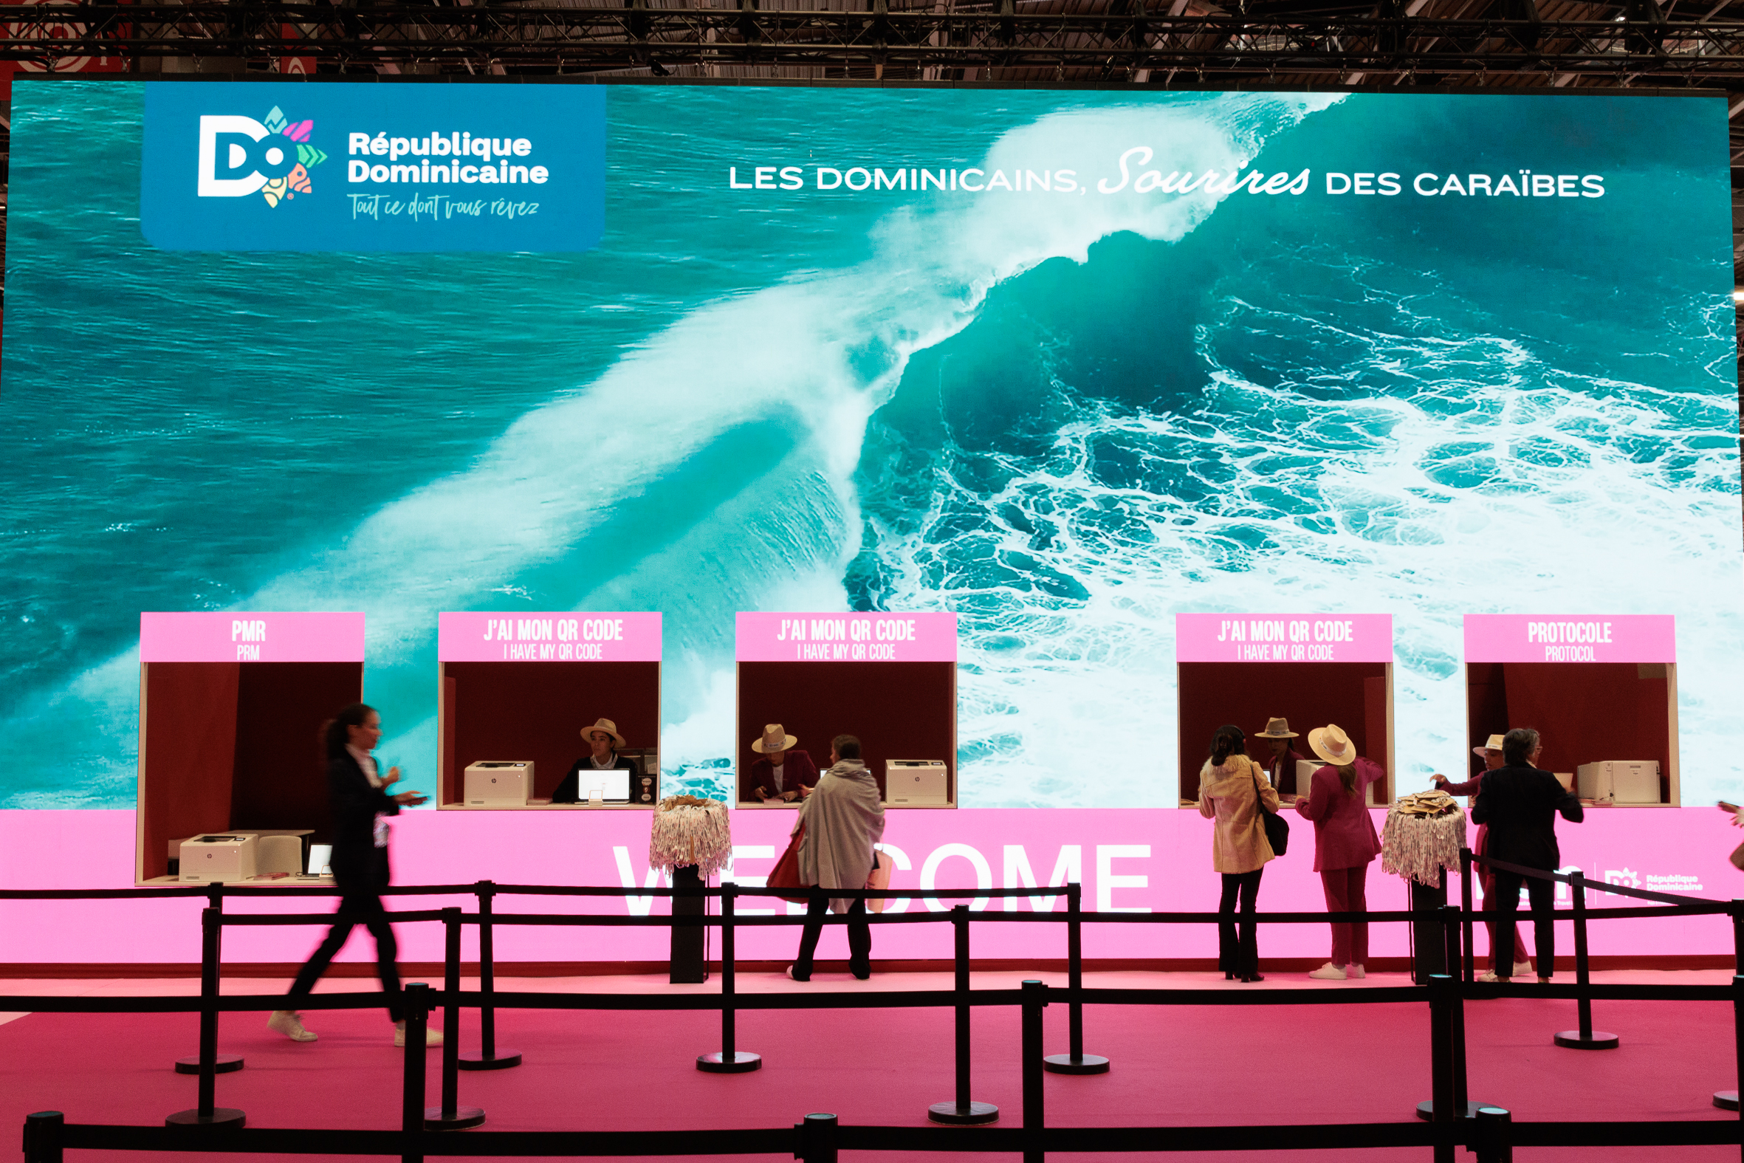
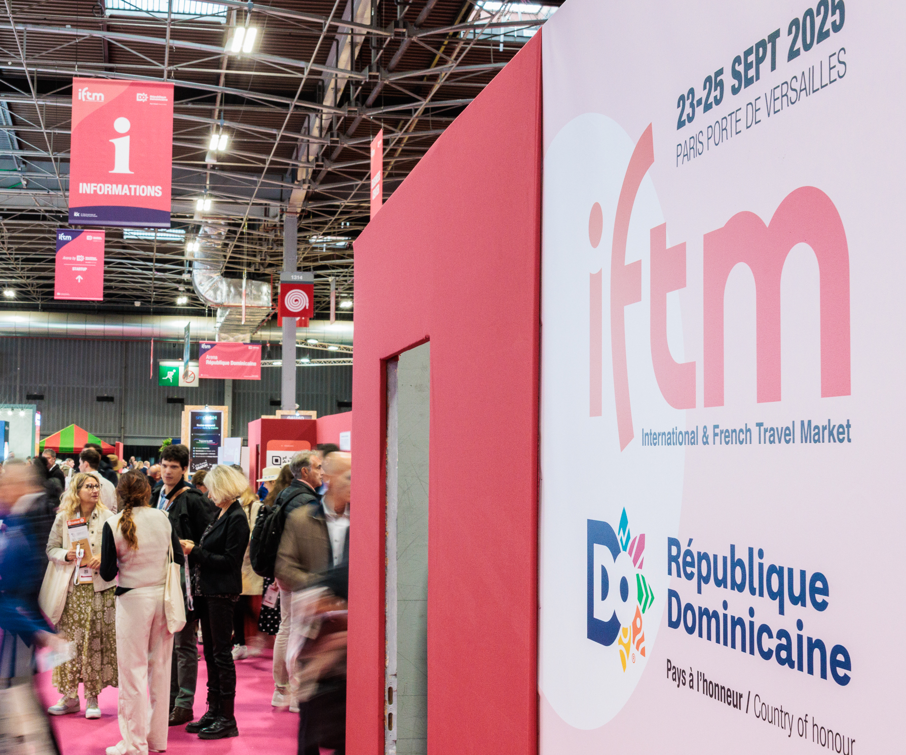
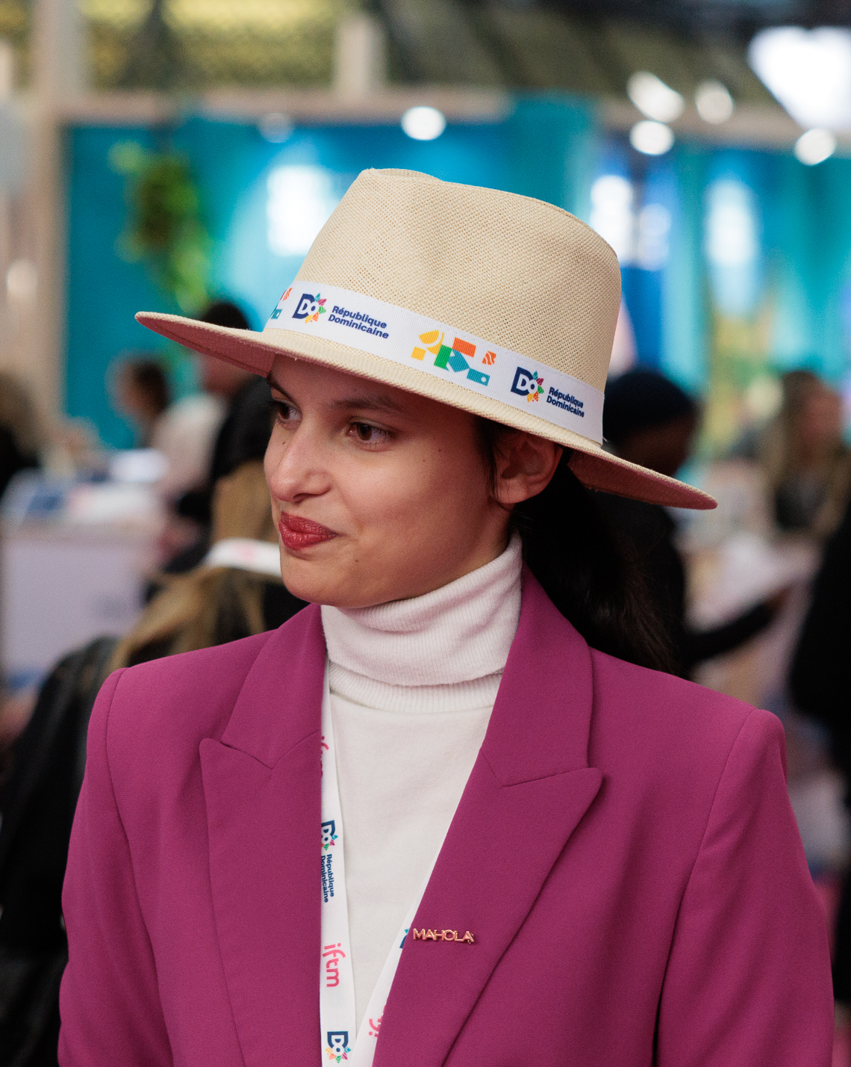
Visibility during the show
Welcome & supports for attendees
Badges, lanyards, show map, IFTM Daily, accessories for welcoming staff, official bags
Signage
Outdoor signage, geant indoor screen video, official photocall, your logo on aisle letter signages
The branding of the biggest conference room
Conference room name, decoration & colors related to your destination
The opening of IFTM
The opening of the show with your country’s music/dance, speech during the opening conference, animations & speech during the opening cocktail
Sponsoring of The Travel Agent Cup
Your destination is discovered and hightlighted by travel agents

Slide 7
Beyond your visibility
Our team & our digital tools are involved to contributing to your success
A dedicated customer success manager to support you in preparing for the exhibition.
A dashboard to manage and measure your actions with tools like Lead Manager, Colleqt and your exhibitor profile. It is your strategic ally for maximizing performance and return on investment before, during, and after the show.
A networking platform for arranging high-quality business meetings, complemented by concierge services.
We are committed to ensuring your experience is both successful and rewarding.

Slide 8

Europe / Asia / Village TO / Croisières
Gwenaelle MARY
+33 (0)1 47 56 52 45 gwenaelle.mary@rxglobal.com
Destination France / Business Travel /
Caraibes / Americas
Rocio PORTILLO
+33 (0)1 47 56 50 51
rocio.portillo@rxglobal.com
CONTACTS US
Middle East / Indian Ocean / Africa &
Mediterranean region /
Generalists / Start-ups / Technologies
Nathalie DALLE
+33 (0)6 34 78 16 93
nathalie.dalle@rxglobal.com

