Slide 1

PRESENTATION - IFTM 2026
15 – 17 SEPT 2026

Slide 2





IFTM 2025:
The 1st B2B event for travel professionals in France
IFTM is the only B2B trade show that brings together all professionals of the French tourism industry: the Leisure, Business, MICE, and Group. IFTM is the starting point of a collective movement towards tourism that is more ambitious, more innovative, and deeply responsible.
Key figures 32,022 visitors
1,650 Brands - 117 Destinations
16,725 Business meetings (+27,7 % vs 2025)
18% International visitors
+90 Conference sessions
800 Press / Media / content creators

Slide 3
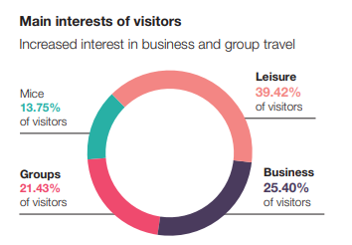
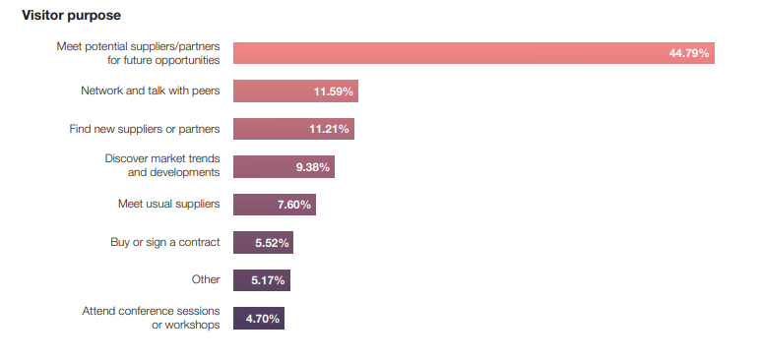
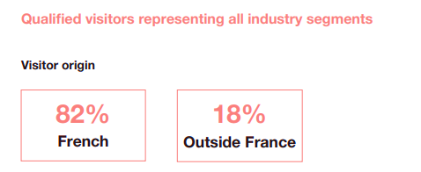
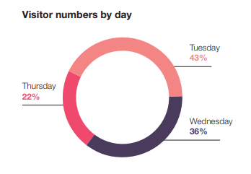
A HIGH-QUALITY VISITOR BASE

Slide 4
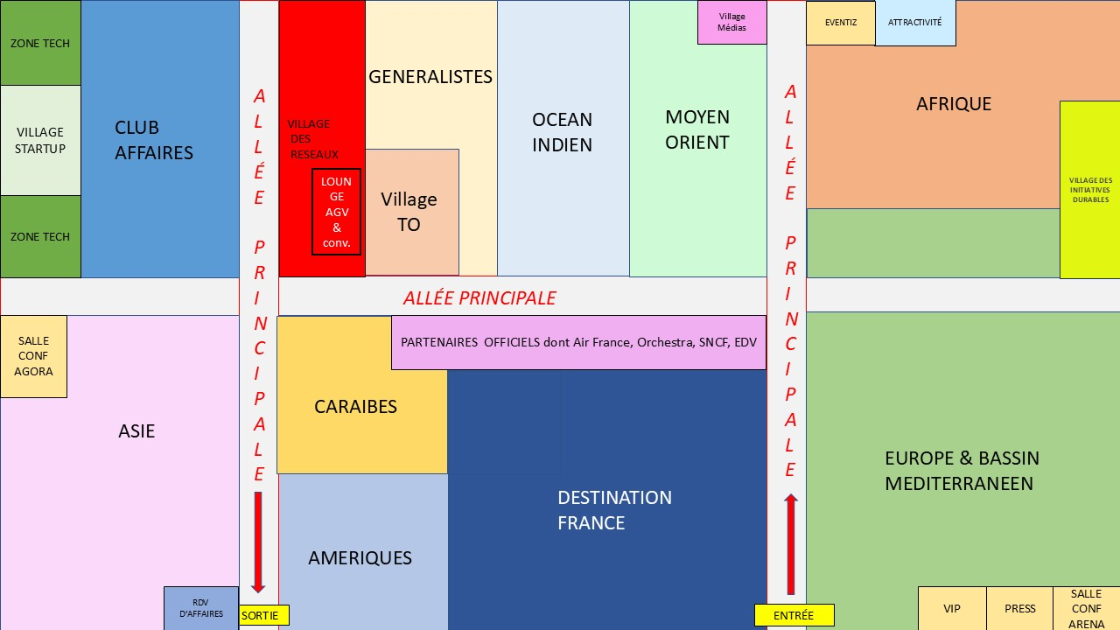
FLOORPLAN 2026 *
*for references, subject to modification

Slide 5
THE ZONE / THE VILLAGE XXX

Slide 6
FOCUS ON XXX

Slide 7


